Slide 1
Town of Shediac
Shediac: A unique experience

Slide 2
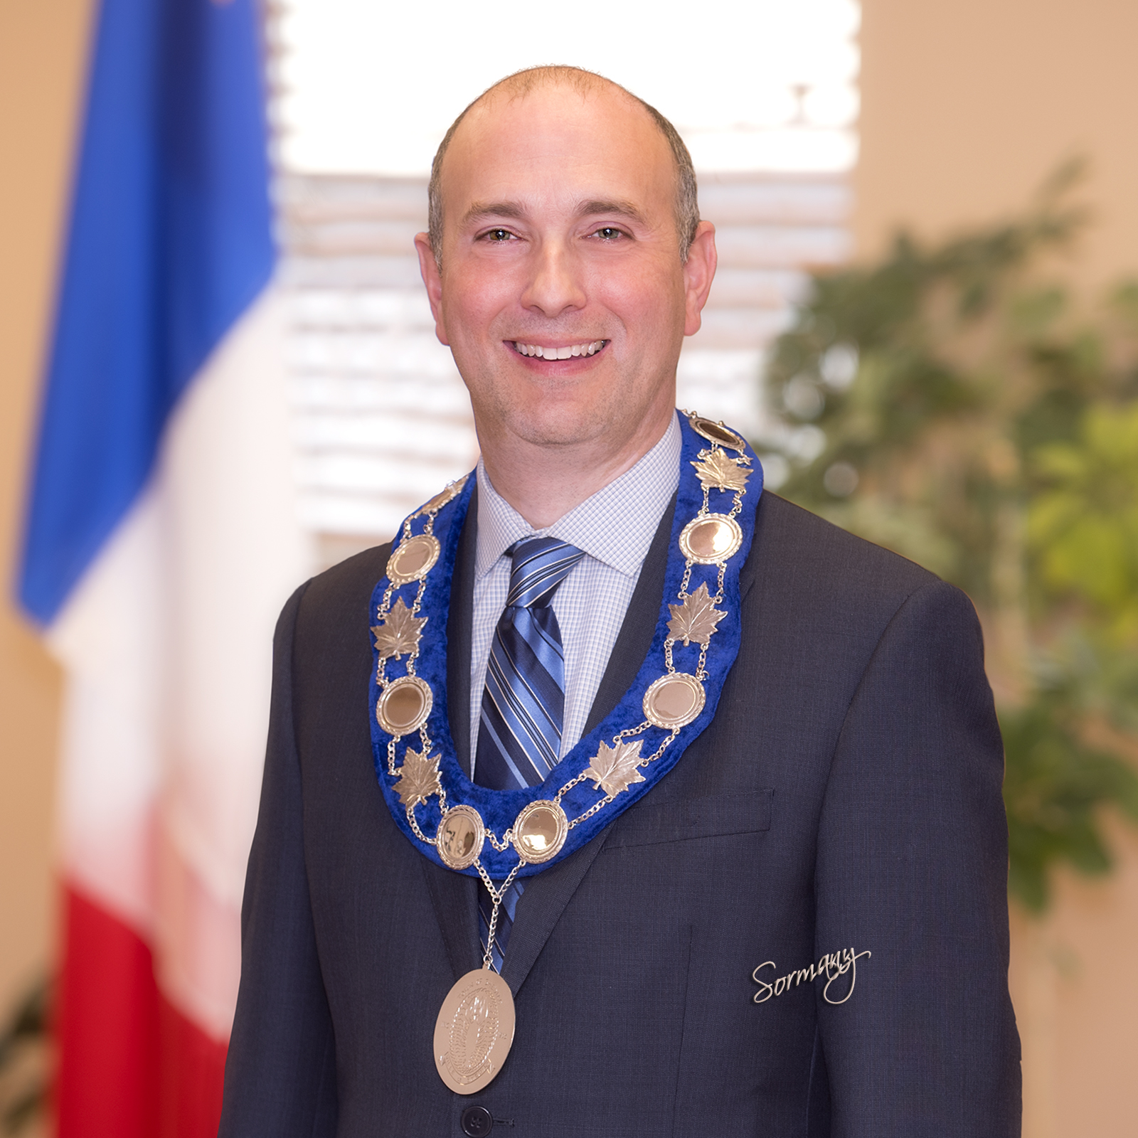
Roger Caissie Mayor Town of Shediac

Slide 3
Married to Natalie Levesque
Two children: Frédéric (13 years old) and Catherine (11 years old)
Elected mayor on December 10, 2018.
Member of Shediac Town Council since 2012.
Not from Shediac, but my family (Caissie) is from Shediac (Sackville Street).
Studied political science and public administration at the Université de Moncton.
Civil servant with the Province of NB.
Involved in municipal politics to help our community grow.

Slide 4
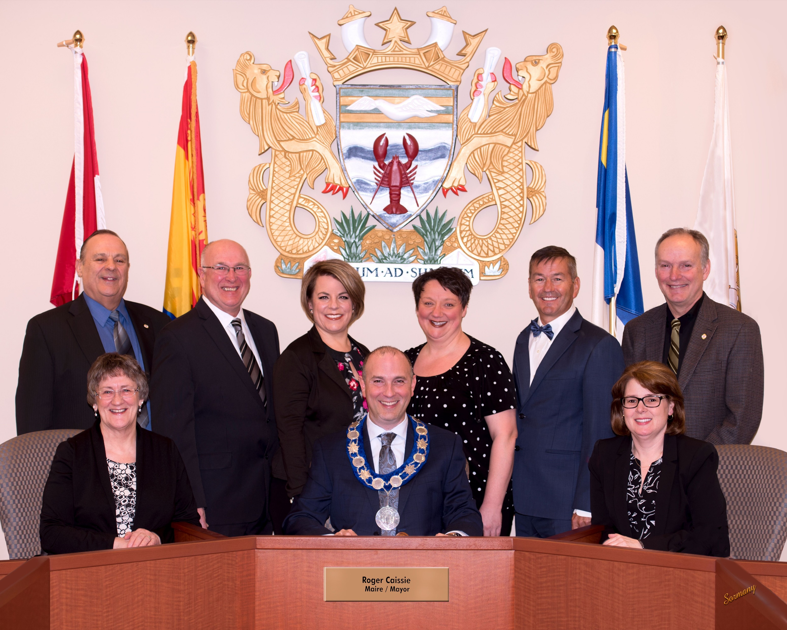
Our Team – Your Council

Slide 5
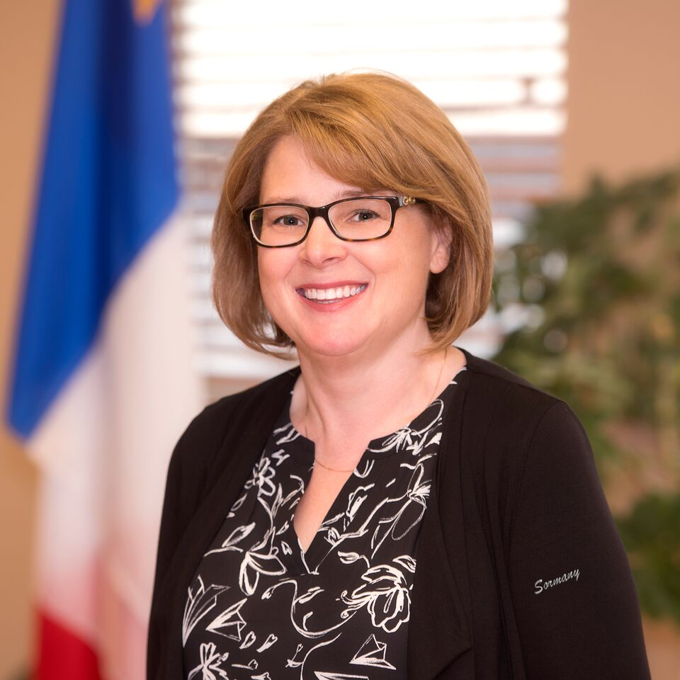
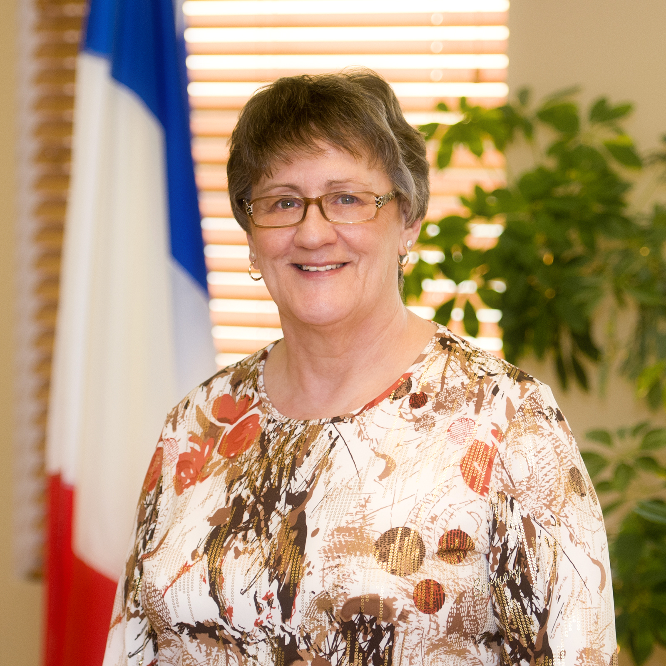
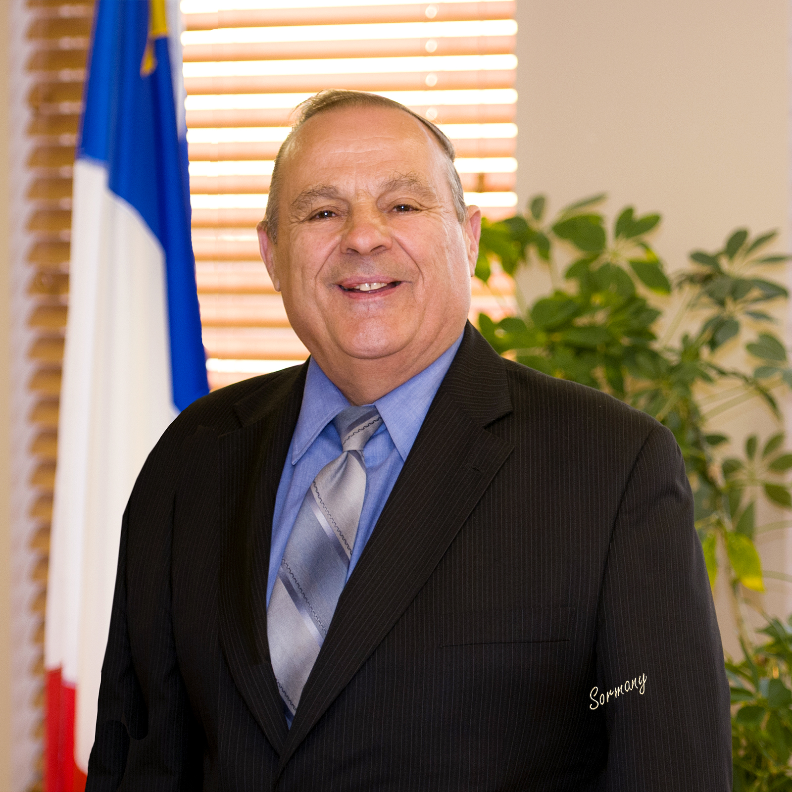
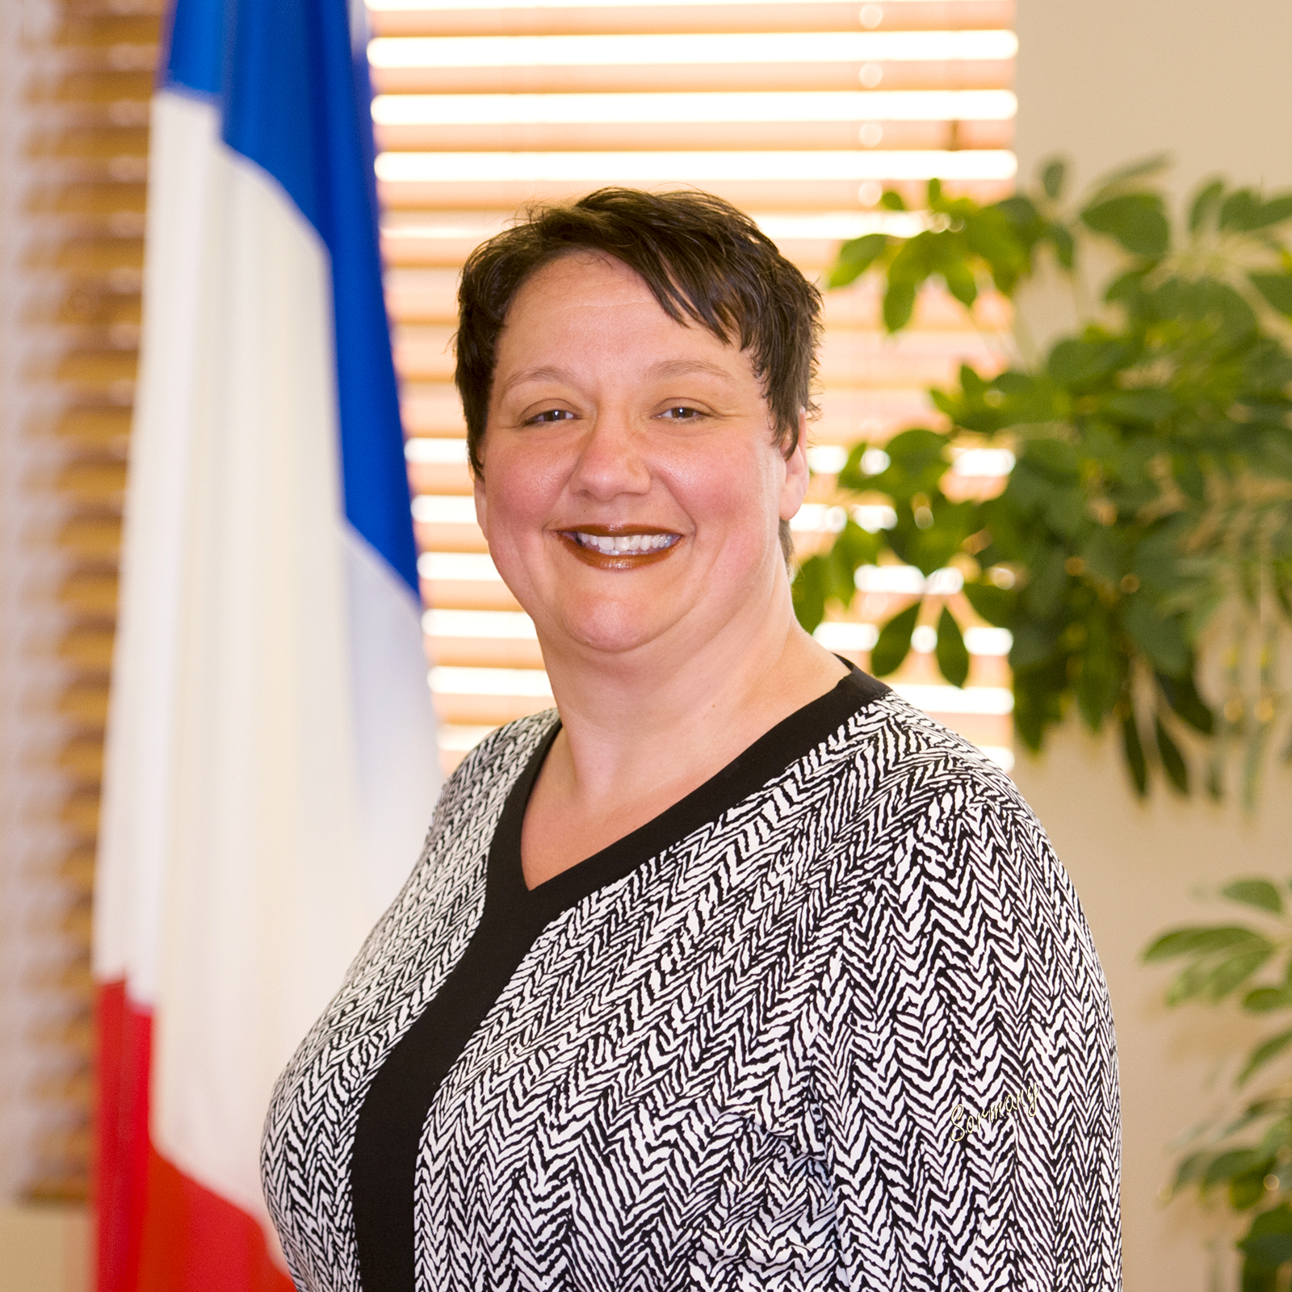
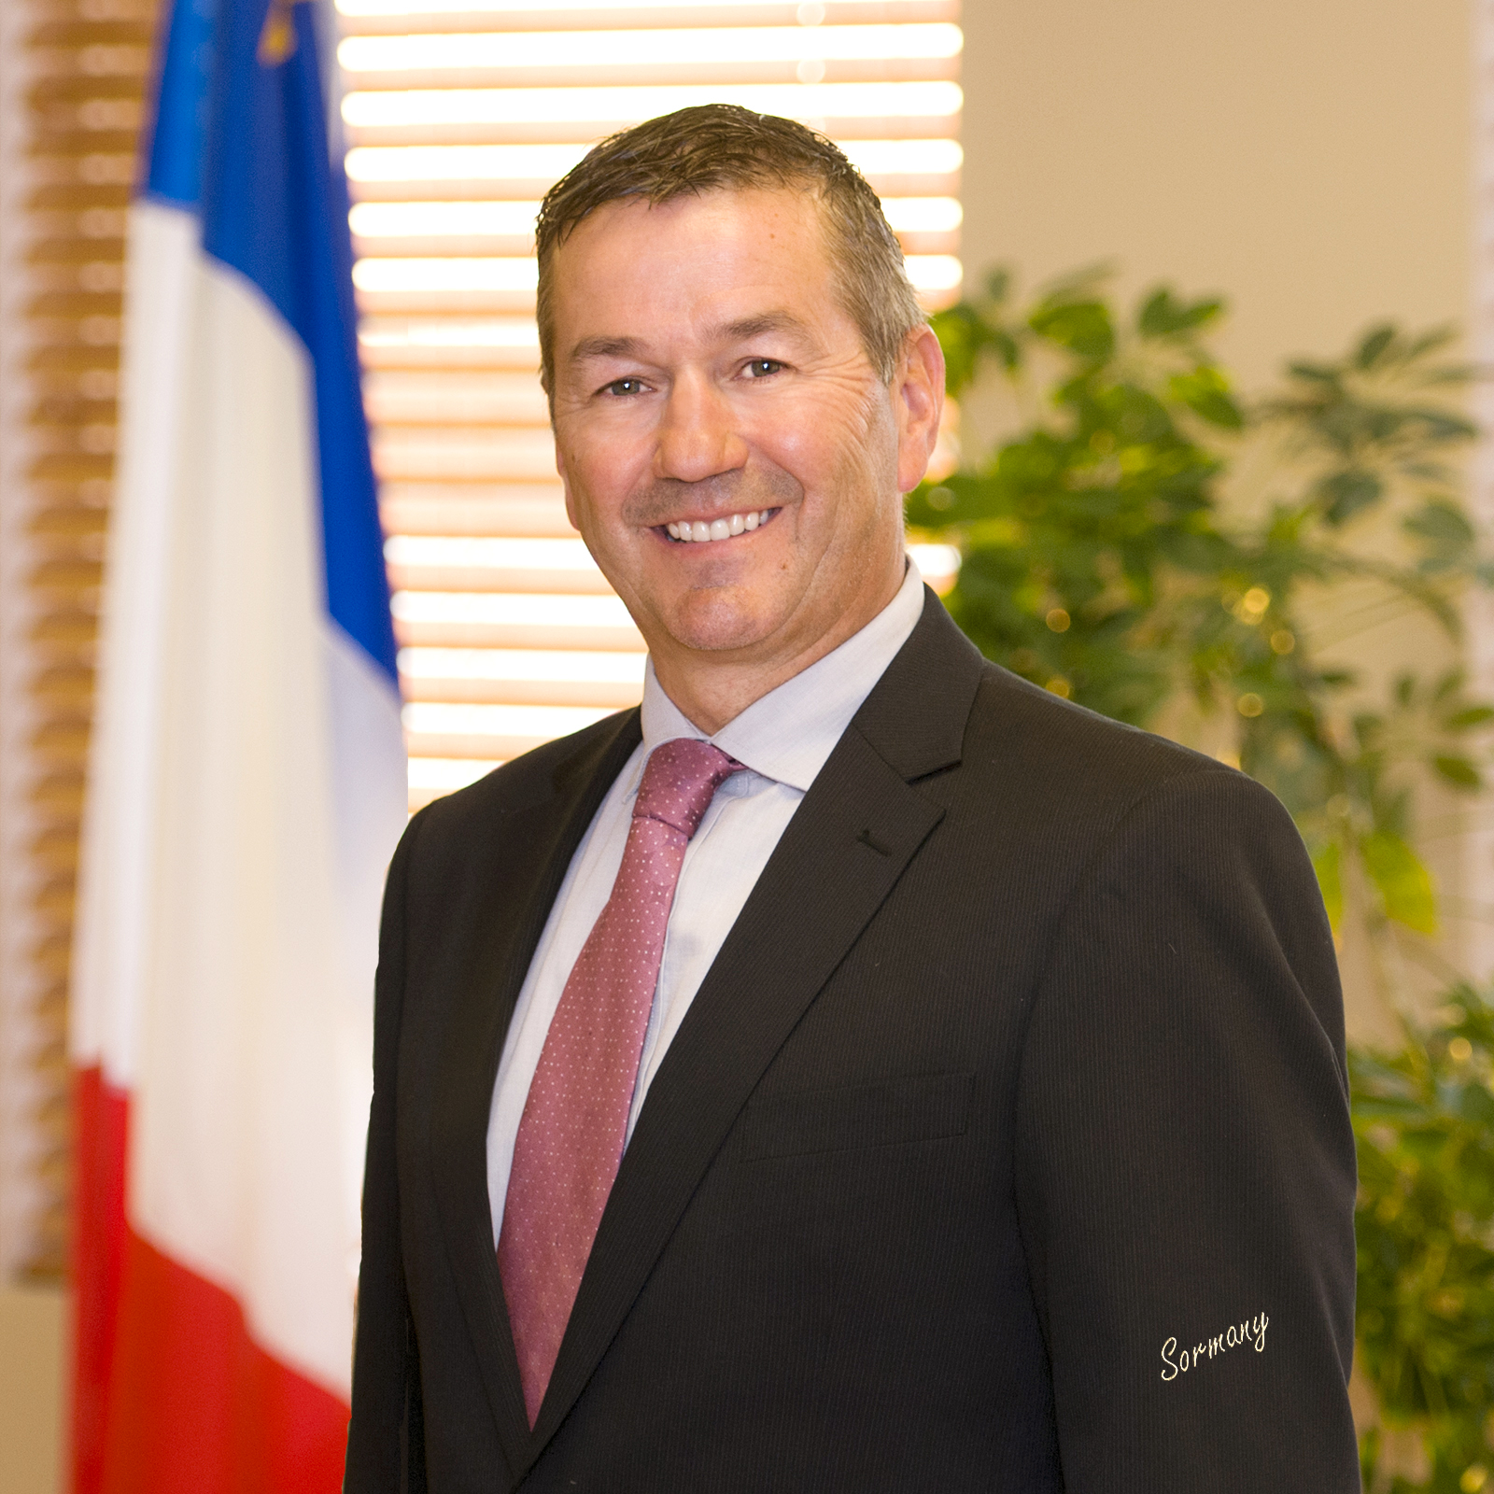
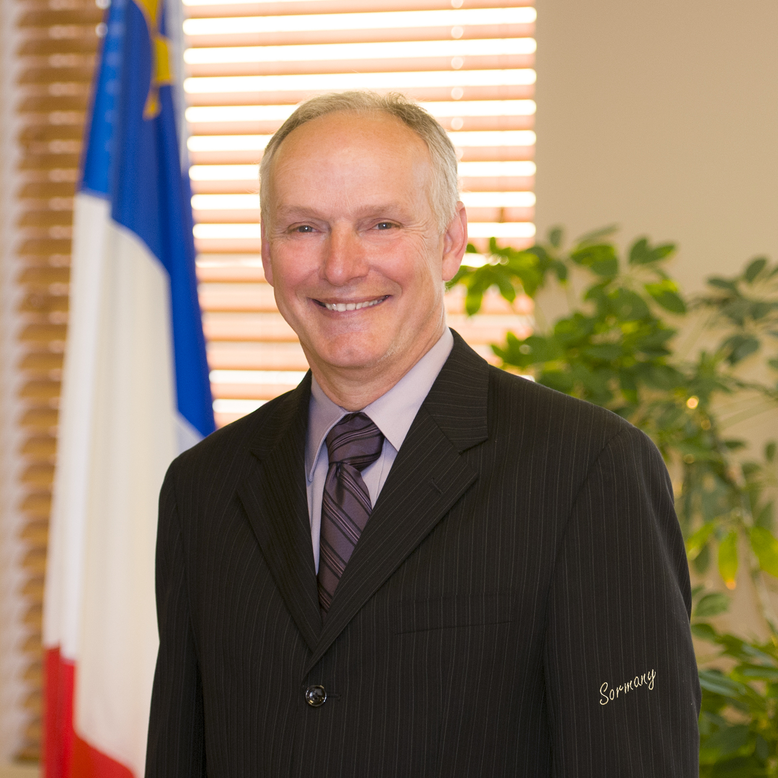
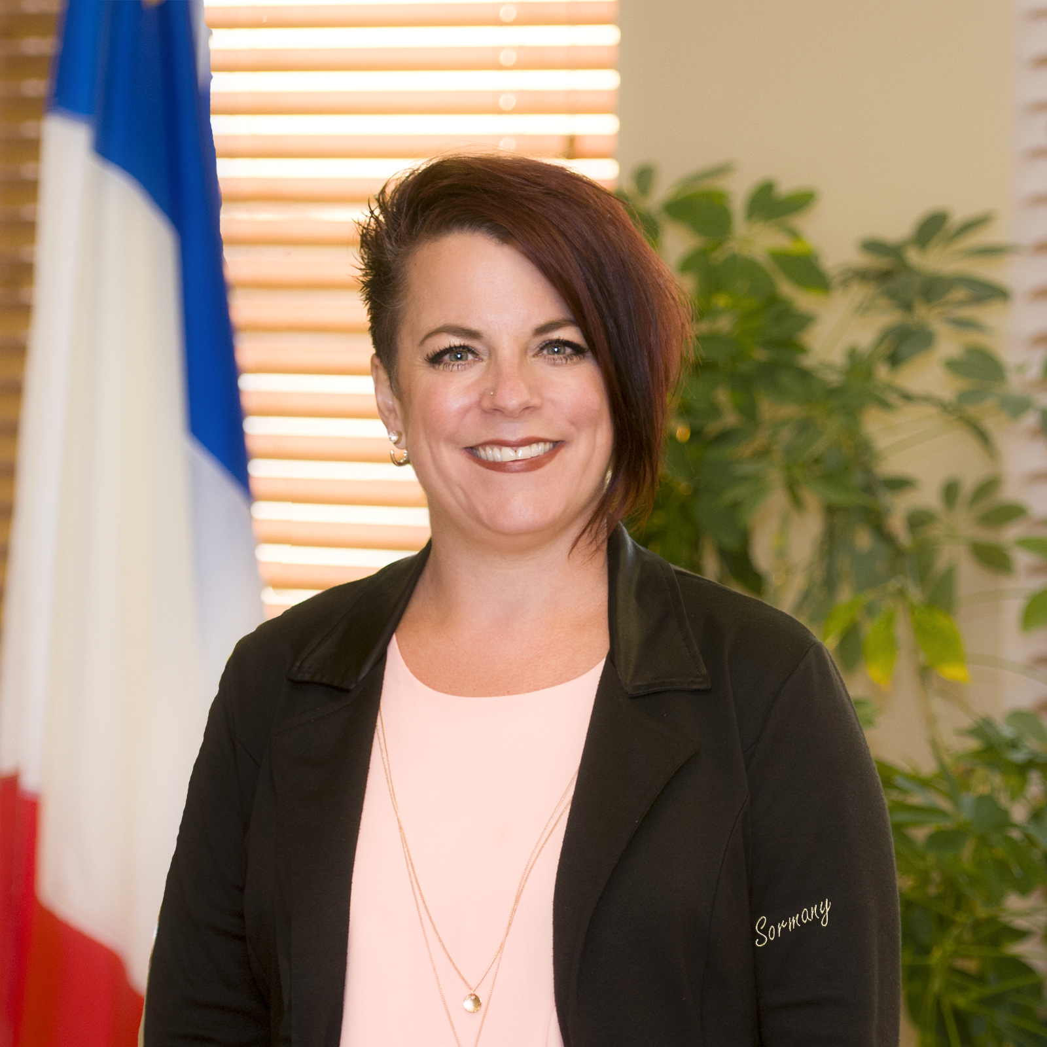
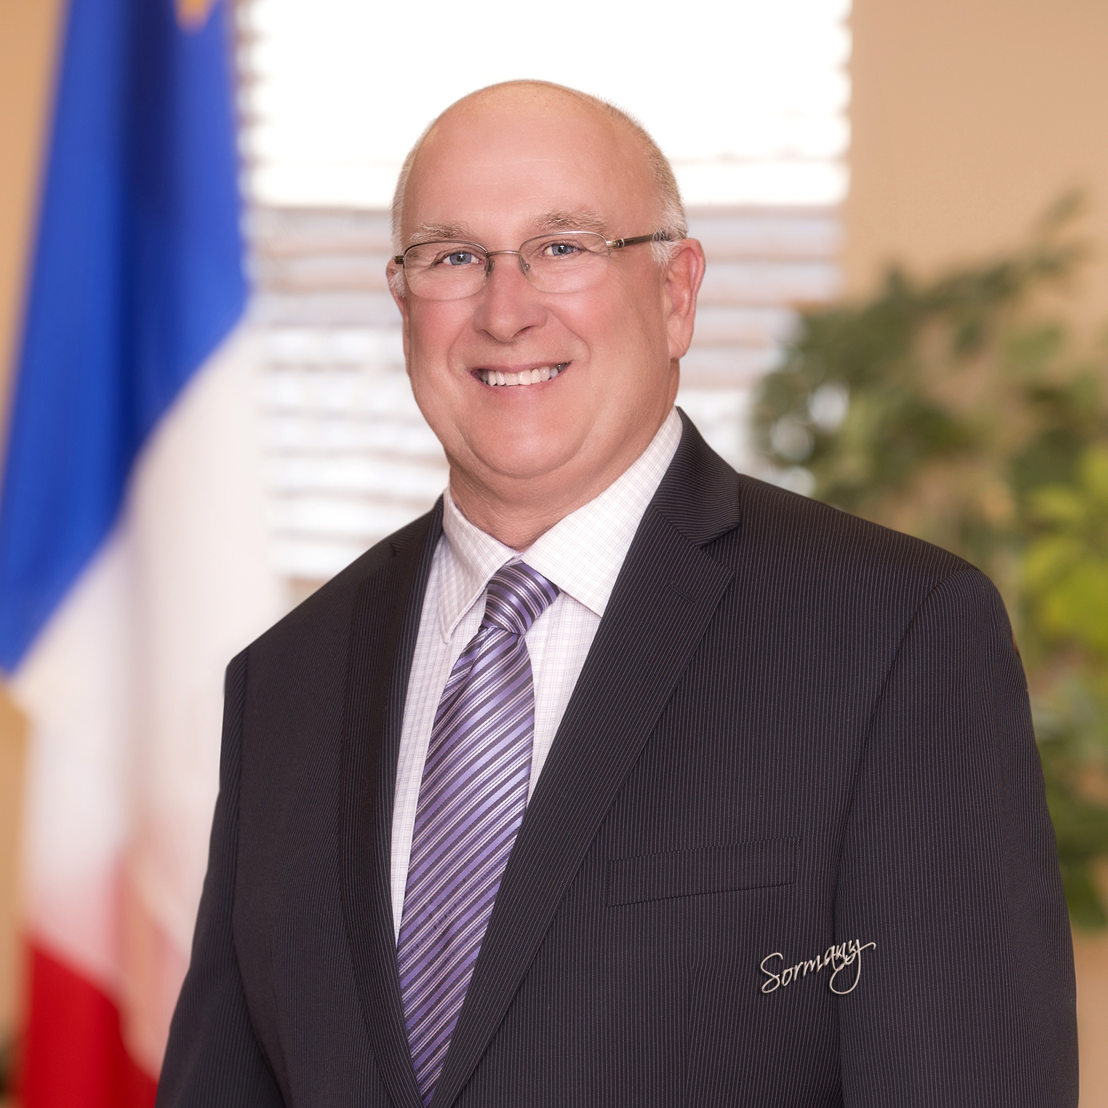
Mayor and Councillors
Patricia Bourque-Chevarie
Laura Gallant
Raymond Cormier
Germaine Gallant
Roger Caissie
Gilles Brine
Paul Boudreau
Sylvie Collette-Boudreau
Jean-Claude Bertin

Slide 6
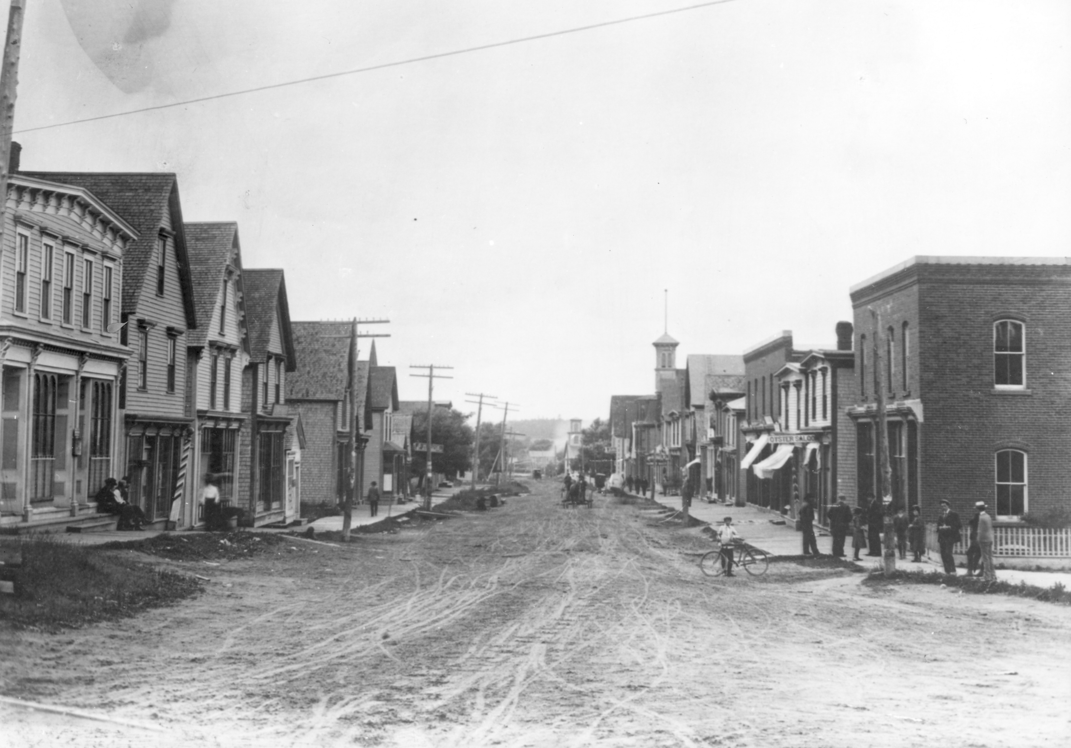
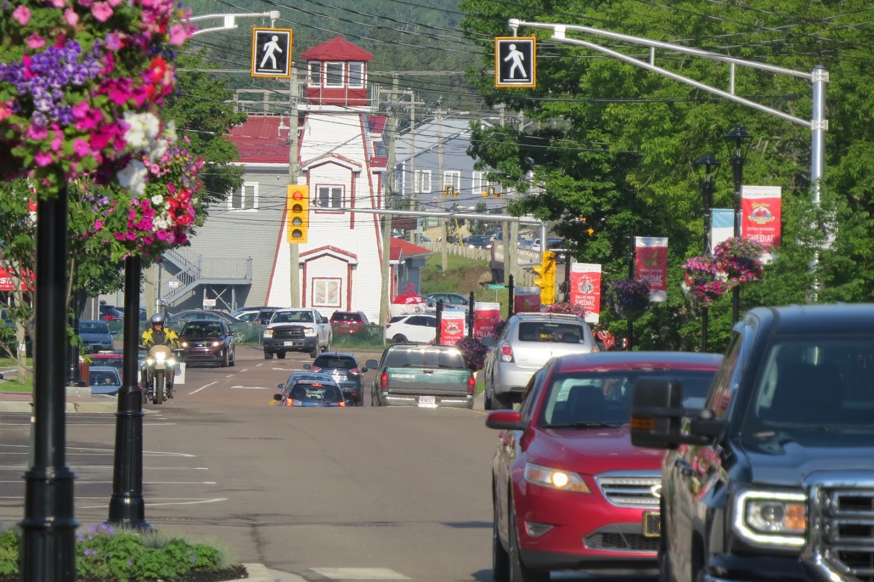
Shediac: A growing town… Its history and its future.
22 % population increase between 2006 and 2016 (10 years), i.e. from 5,497 to 6,664.
Tax base growth of 5.28 % per year on average over the past 10 years.

Slide 7
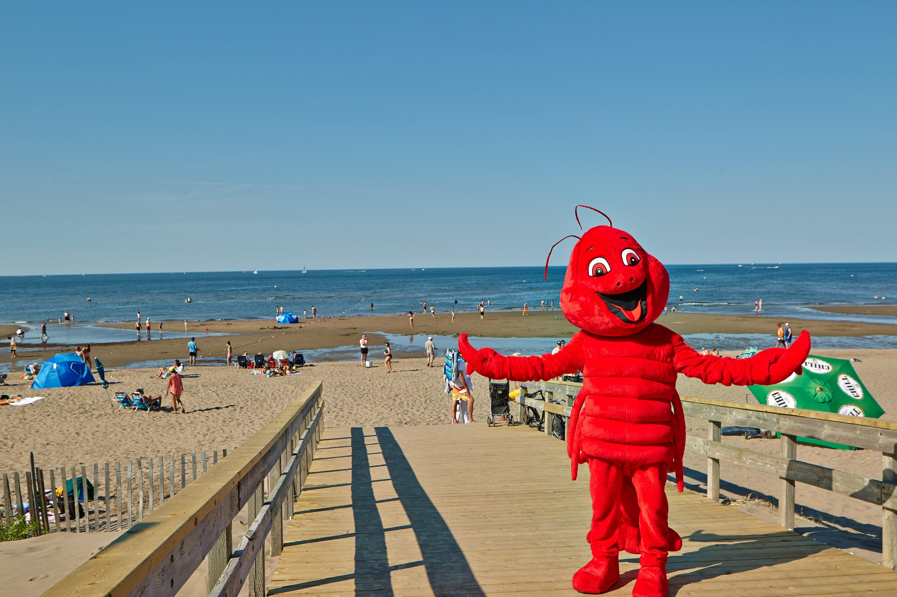
Shediac: Organizations that contribute to sustained growth.
John Lyons Foundation ($2.2 M invested in the community over 10 years);
Vestiaire St-Joseph (34 years serving the less fortunate, provides food to 350 families monthly (including 106 families in Shediac);
Maurice Léger Foundation (Kickball Tournament). More than $570,000 raised over the past 10 years.
Lobster Festival (70th edition in 2019). Budget of $173,000 in 2013
to close to $500,000 in 2018.
Rotary Club, Knights of Columbus,
Royal Canadian Legion, etc.

Slide 8
Shediac: 2018 and 2019 highlights
Tax base increase of 4.16 % in 2019
Tax rate of $1.4984 in 2019
Dieppe $1.6295
Moncton $1.6497
Riverview $1.5926
Budget of $12.3 M in 2019
Tax base of $682 M in 2019
$25 M worth of building permits in 2018

Slide 9
Town of Shediac
2019 Operating Budget
REVENUES (SUMMARY) | BUDGET 2019 | %
Warrant | 10,183,166 | 80.9%
Equalization grant | 646,898 | 5.1%
Recreation and cultural services | 533,100 | 4.2%
Other transfers | 507,500 | 4.0%
Fire Department | 351,897 | 2.8%
Fiscal services | 176,029 | 1.4%
Economic development / Tourism | 110,000 | 1.0%
Transportation | 53,000 | 0.4%
Administrative | 26,800 | 0.2%
 | 12,588,390 | 100.0%

Slide 10
Town of Shediac
2019 Operating Budget (Cont’d)
EXPENDITURES (SUMMARY) | BUDGET 2019 | %
Recreation and community services | 2,445,924 | 19.5%
Transportation | 2,181,508 | 17.3%
Fiscal services | 1,652,674 | 13.1%
General administrative/Human resources | 1,627,405 | 12.9%
Police protection | 1,384,423 | 11.0%
Capital paid by operation | 1,077,541 | 8.6%
Fire Department | 772,873 | 6.1%
Economic development/Tourism | 562,858 | 4.5%
Environmental health | 348,246 | 2.8%
Planning services | 287,038 | 2.3%
Legislative | 217,900 | 1.7%
Animal and pest control | 30,000 | 0.2%
 | 12,588,390 | 100.0%

Slide 11
Building permits in 2018 compared to 2017
Comparing January to December
2017 |  | 2018 |  | % growth
Value of residential permits | $4,536,524 = 31 % | Value of residential permits | $5,685,324 = 32,5% | +25%
Value of multi-family residential permits | $4,249,576 = 29% | Value of multi-family residential permits | $8,146,002 = 22,5% | +92%
Value of commercial permits | $5,859,934 = 40% | Value of commercial permits | $11,526,410 = 45% | +97%
TOTAL January to December 2017 | $14,646,034 = 100% | TOTAL January to December 2018 | $25,357,736 = 100% | TOTAL +73%
TOTAL for 2017 | $14,646,034 | TOTAL for 2018 | $25,357,736

Slide 12
Investing in our future
Accomplishments in 2018
Buildings
Water tower, Ohio Road $3.3 M
Signage
Signs along Route 11 and 15 (landscaping planned for 2019) $65,000
LED signs at town entry points
Routes
Bellevue Street $176,000
Tipperary Street $567,000
Main Street (phase III) $200,000
Equipment
Fire truck $632,000
Various equipment items and machinery (public works and recreation) $143,000 Total $5 M

Slide 13
Investing in our future
Projects related to municipal operations - 2019
Routes
Gallagher Street, complete reconstruction $3.9 M
Ohio Road, trail and sewers (Champlain Street to future Breaux Bridge Street) $400,000
Ohio Road, extension of water pipes and sanitary sewers $634,000
Equipment
Various equipment items and machinery $125,000
Water
Repair work on water tower on Breaux Bridge Street $920,000
Total $6 M

Slide 14
Projects and objectives in 2019
Congrès mondial acadien from August 10-24, 2019
Family hubs from August 10-20
(seven families: Boudreau, Duguay, Forest, LeBlanc, Mallet, Richard, Robichaud)
Closing Ceremony (August 24)
Regional Green Strategy; Ecovision 2025
Partnership between three municipalities (Shediac, Beaubassin-est and Cap-Pelé)
Launch of Ecovision 2025 in 2018
Tourism Strategy: Experience Shediac
Survey conducted among business people members of the Chamber of Commerce
Investment in 2018 ($50,000, i.e. $25,000 from the Town and $25,000 from the Province)
Investment in 2019 ($50,000 from the Town and awaiting word from the Province on
an additional $50,000)
Application for funding with ACOA ($500,000) for 2019 and 2020
Climate Change Adaptation Plan, Asset Management Plan
Memorandum of understanding with Charlottetown
Memorandum of understanding with Pointe-du-Chêne Port Authority

Slide 15
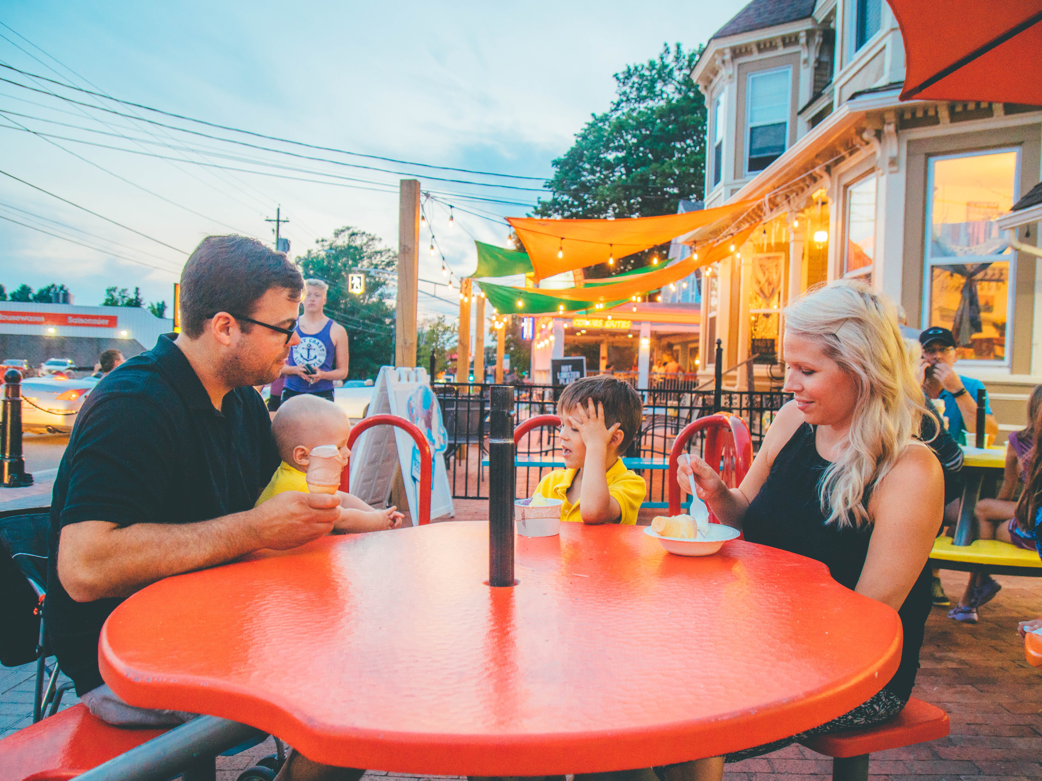
Projects and objectives in 2019 (Cont’d)
New marketing video (Exclusive)

Slide 17
Projects and objectives in 2019 (Cont’d)
Tourism Marketing Strategy: Experience Shediac https://www.experienceshediac.ca/

Slide 18
Conclusion Shediac: Open for business
Carry forward Council’s vision
Work with our partners (Chamber of Commerce, Downtown Corporation, organizations, etc.) to achieve our mission: team work
Provide a unique experience to our citizens and visitors: Shediac

Slide 19
Questions ?

